Slide 1



MPIG Open Seminar 00133
Anomaly detection
袁洪慧
Machine Perception and Interaction Group (MPIG)
www.mpig.com.cn
yhh@mpig.com.cn
公众号:
mpig_robot

Slide 2
Outline
Problem Motivation
Gaussian Distribution
Algorithm
Developing and Evaluating an Anomaly Detection System
Anomaly Detection VS. Supervised Learning
Choosing What Features to Use
Multivariate Gaussian Distribution
Anomaly Detection using the Multivariate Gaussian Distribution

Slide 3
Problem motivation

Slide 4








Anomaly detection example
Aircraft engine features:
= heat generated
= vibration intensity
… …
Dataset: { , ,….., }
New engine:
$x^{(1)}$
$$x^{(2)}$$
$$x^{(m)}$$
$$x_{1}$$
$$x_{2}$$
$$x_{test}$$
vibration)
(
(
heat)

Slide 5
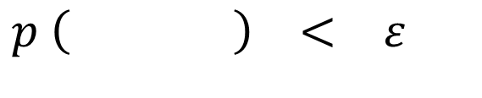








Density estimation
Is anomalous ?
Dataset: { , ,….., }
$x^{(1)}$
$$x^{(2)}$$
$$x^{(m)}$$
$$x_{test}$$
$$x_{test}$$
$$p \left( \right) < ε$$
vibration)
(
anomaly
$$x_{test}$$
$$p \left( \right) ε$$
$$≥$$
OK
(
heat)

Slide 6



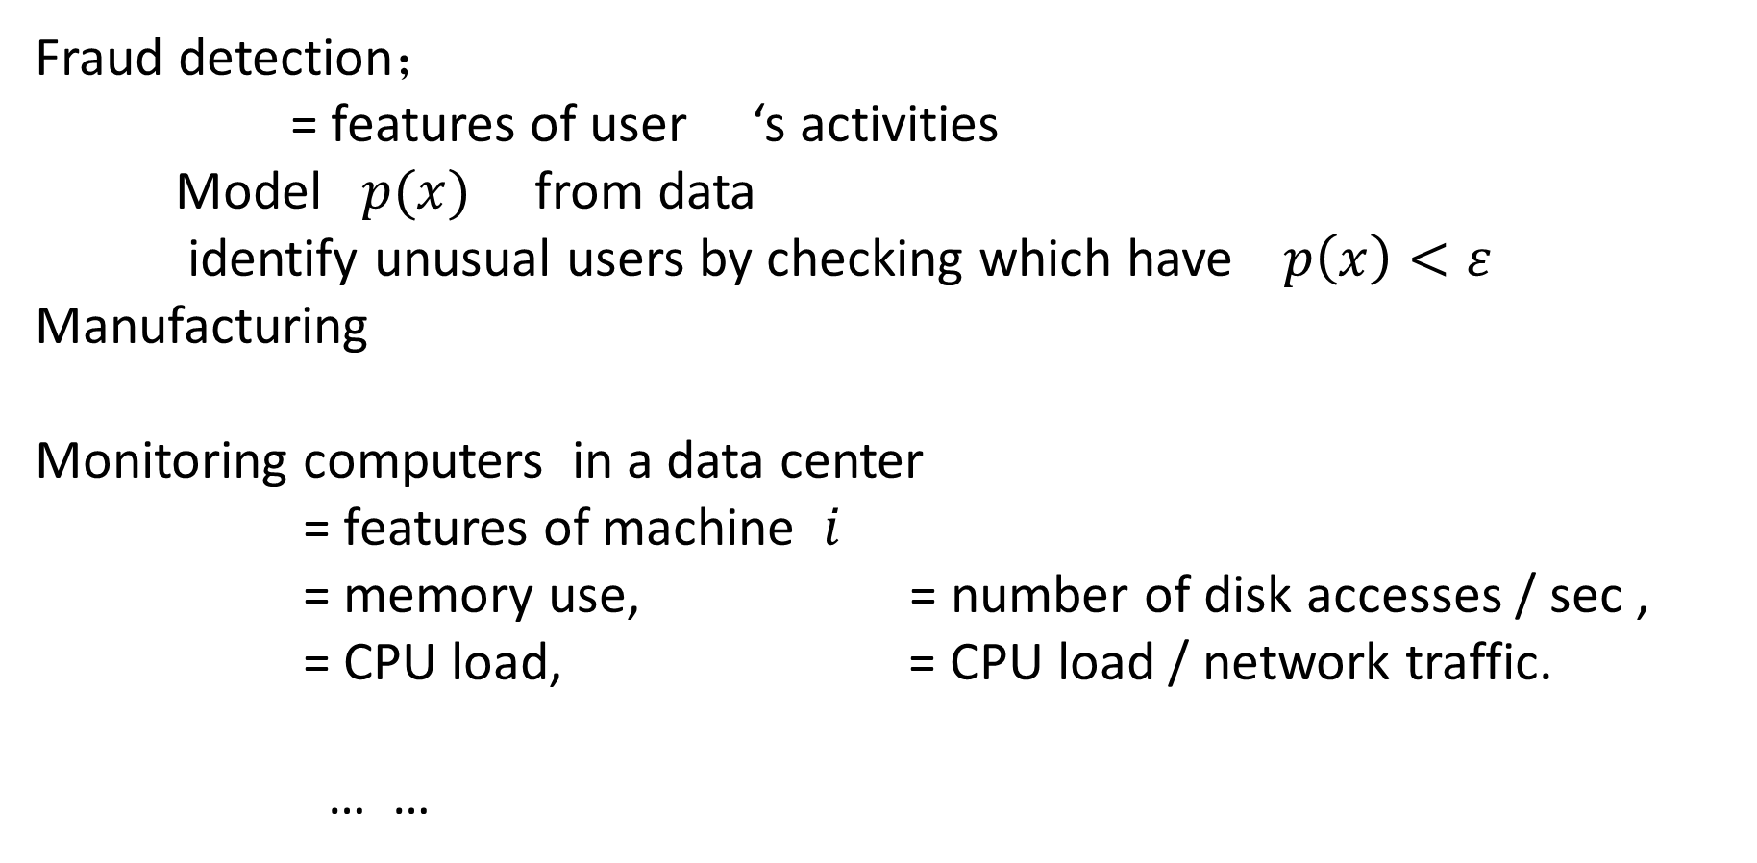



Anomaly detection example
Fraud detection；
= features of user ‘s activities
Model $p(x)$ from data
identify unusual users by checking which have$p\left(x\right)<ε$
Manufacturing
Monitoring computers in a data center
= features of machine $i$
= memory use, = number of disk accesses / sec ,
= CPU load, = CPU load / network traffic.
… …
$x^{(i)}$
$x^{(i)}$
$$x_{1}$$
$$x_{2}$$
$$x_{3}$$
$$x_{4}$$

Slide 7
Gaussian distribution

Slide 8
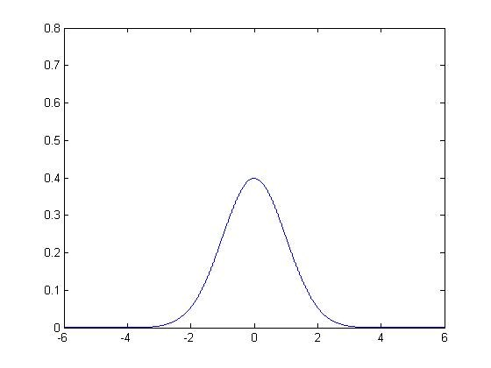

Gaussian (normal) distribution
Say . If $x$ is a distributed Gaussian with mean $μ$ , variance $σ^{2}$ .
$$x∈R$$
function p = gaussian1d(mu, sigma, x)
p = 1 / (sigma * sqrt(2 * pi)) * ...
exp(-(x - mu).^2 / (2 * sigma^2));
end
P66

Slide 9
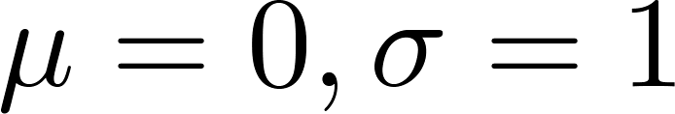

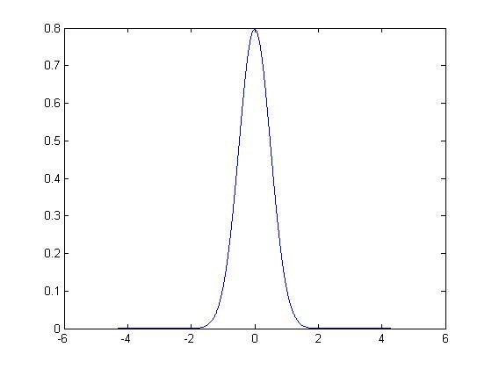
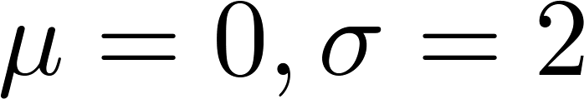

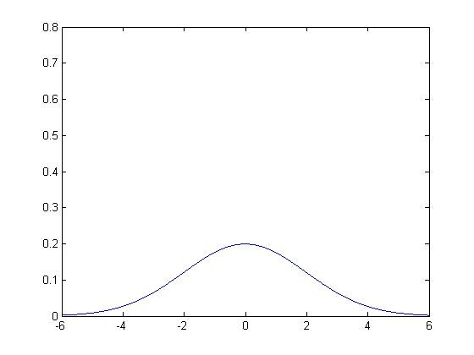
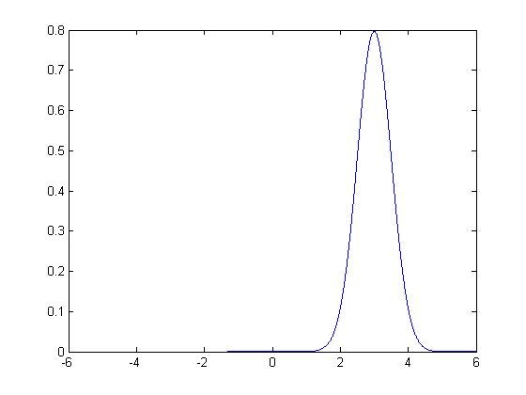
Gaussian distribution example
P66
Andrew Ng

Slide 10
Gaussian distribution example
close all; clc; clear all;
x = -6 : 0.01 : 6;
mu = 0;
sigma = 2;
p = gaussian1d(mu, sigma, x);
fprintf('The integration of p with respect to x is %.f\n', trapz(x, p));
%%
h = figure('name','One D Gaussian distribution');
hold on;
plot(x, p, 'b-', 'linewidth', 4);
plot([mu, mu], [min(p), max(p)], 'r-', 'linewidth', 4);
box on;
title(sprintf('\\mu = %.1f, \\sigma = %.1f', mu, sigma))
% set(gca,'Visible','off');
xlabel('x');
ylabel('P(x)');
grid on;
grid minor;
print(h, '-dpng', 'guassian1d.png');
P66

Slide 11
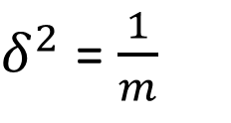

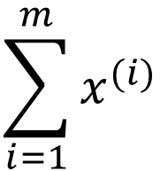


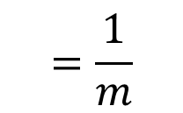

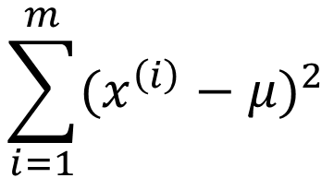
Parameter estimation
Dataset:{ , ,… … , }${ x}^{(i)} ∈ R$
$x^{(1)}$
$x^{(2)}$
${ x}^{(m)}$
P68
$$\sum_{i=1}^{m}{x^{(i)}}$$
$$=\frac{1}{m}$$
$$μ$$
$$\sum_{i=1}^{m}{{(x^{\left(i\right)}−μ)}^{2}}$$
$δ^{2}$ = $\frac{1}{m}$

Slide 12
Parameter estimation
function [mu sigma2] = estimateGaussian(X)
%ESTIMATEGAUSSIAN This function estimates the parameters of a
%Gaussian distribution using the data in X
% [mu sigma2] = estimateGaussian(X),
% The input X is the dataset with each n-dimensional data point in one row
% The output is an n-dimensional vector mu, the mean of the data set
% and the variances sigma^2, an n x 1 vector
% Useful variables
[m, n] = size(X);
% You should return these values correctly
mu = zeros(n, 1);
sigma2 = zeros(n, 1);
mu = mean(X);
sigma2 = 1 / m * sum ( bsxfun(@minus, X, mu) .^2 );
end
P68

Slide 13
algorithm

Slide 14

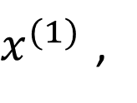
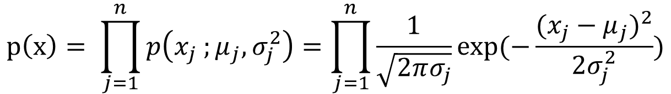
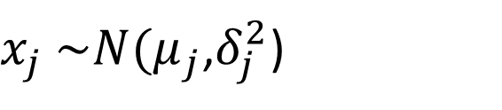

Density estimation
Training set : { … … , }
Each example is
$x^{(1)}$ ,
$x^{(m)}$
$$x ε R^{n}$$
$x_{j}$ $\sim N(μ_{j}$,$δ_{j}^{2}$)
$$p\left(x\right)= \prod_{j=1}^{n}{p\left(x_{j} ;μ_{j},σ_{j}^{2}\right)=\prod_{j=1}^{n}{\frac{1}{\sqrt{2πσ_{j}}}exp⁡(−\frac{{(x_{j}−μ_{j})}^{2}}{2σ_{j}^{2}}}})$$

Slide 15
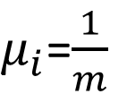
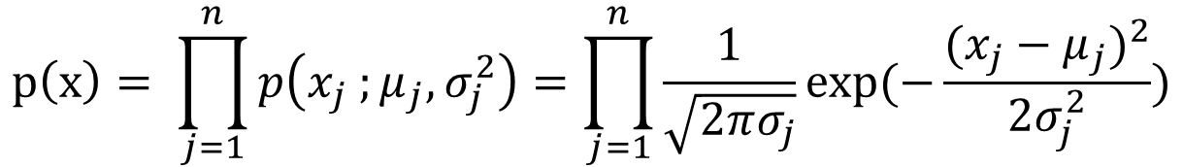


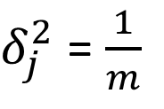

Anomaly detection algorithm
Choose features $x_{i}$ that you think might be indicative of anomalous examples .
Fit parameters $μ_{1}$ ,… … $μ_{n} ,δ_{1}^{2}$ , … … , $δ_{n}^{2}$
3.Given new example $x$ ,compute $p (x)$:
Anomaly if $p \left(x\right)< ε$
$$\sum_{i=1}^{m}{x_{j}^{(i)}}$$
$μ_{i}$=$\frac{1}{m}$
$$\sum_{i=1}^{m}{{(x_{j}^{\left(i\right)}−μ_{j})}^{2}}$$
$δ_{j}^{2}$ = $\frac{1}{m}$
$$p\left(x\right)= \prod_{j=1}^{n}{p\left(x_{j} ;μ_{j},σ_{j}^{2}\right)=\prod_{j=1}^{n}{\frac{1}{\sqrt{2πσ_{j}}}exp⁡(−\frac{{(x_{j}−μ_{j})}^{2}}{2σ_{j}^{2}}}})$$

Slide 16
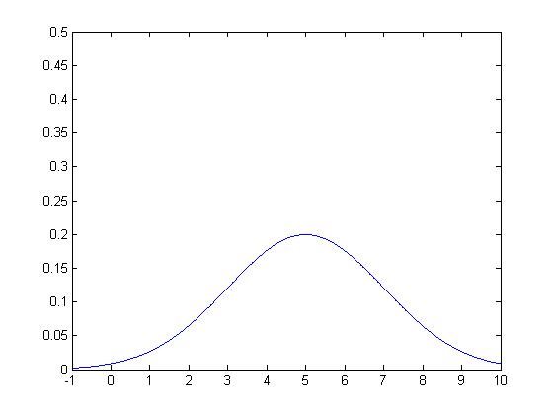
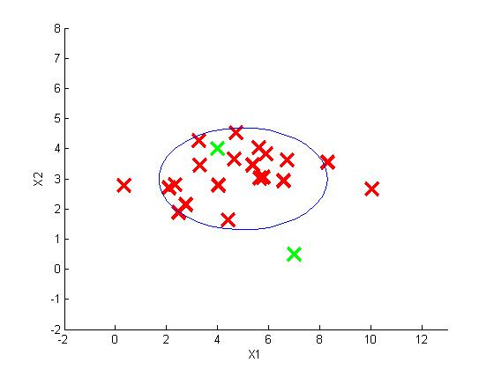

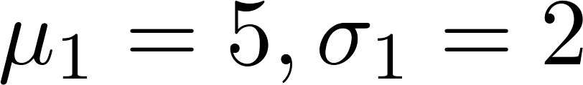


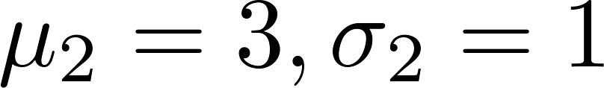
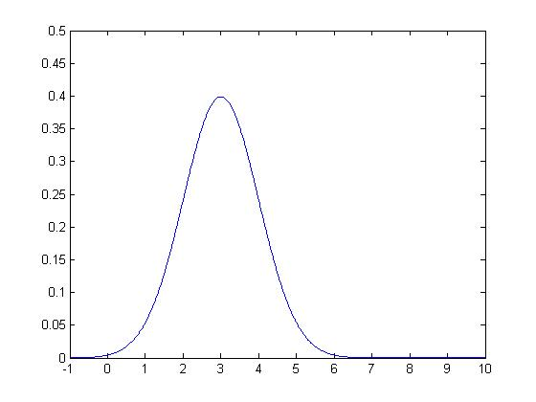
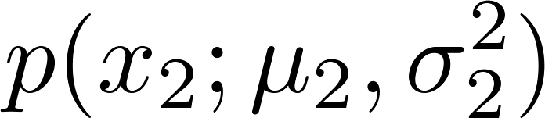
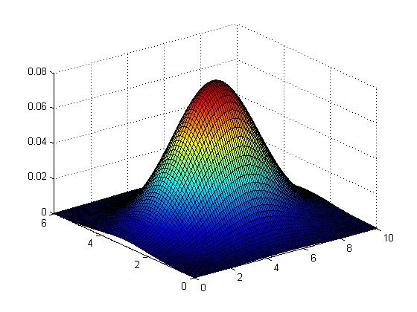

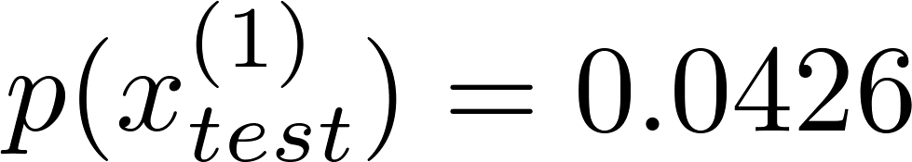
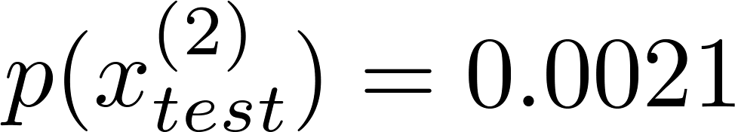
Anomaly detection example
P68

Slide 17
Anomaly detection example
P68
[mu sigma2] = estimateGaussian(X);
p = multivariateGaussian(X, mu, sigma2);
visualizeFit(X, mu, sigma2);
xlabel('Latency (ms)');
ylabel('Throughput (mb/s)');
pval = multivariateGaussian(Xval, mu, sigma2);
[epsilon F1] = selectThreshold(yval, pval);
outliers = find(p < epsilon);
hold on
plot(X(outliers, 1), X(outliers, 2), 'ro', 'LineWidth', 2, 'MarkerSize', 10);
hold off
fprintf('Program paused. Press enter to continue.\n');

Slide 18
Developing and evaluating
an anomaly
detection system

Slide 19

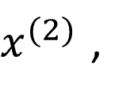

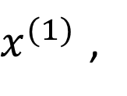



The importance of real-number evaluation
When developing a learning algorithm ( choosing features , etc . ) ,
Making decisions is much easier if we have a way of evaluating our learning algorithm.
Assume we have some labeled data, of anomalous and non-anomalous examples . ( y = 0 if normal, y =1 if anomalous).
Training set : … ( assume normal examples / not anomalous)
Cross validation set: ,…,
Test set: ,….,
$x^{(1)}$ ,
$x^{(2)}$ ,
$x^{(m)}$
$$\left(x_{cv}^{(1)},y_{cv}^{(1)}\right)$$
$$\left(x_{cv}^{(m_{cv})},y_{cv}^{(m_{cv})}\right)$$
$$\left(x_{test}^{(1)},y_{test}^{(1)}\right)$$
$$\left(x_{test}^{(m_{test})},y_{test}^{(m_{test})}\right)$$

Slide 20
Aircraft engines motivating example
10000 good (normal) engines,20 flawed engines (anomalous)
Training set :
6000 good engines
CV :
2000 good engines ( y = 0) , 10 anomalous ( y = 1)
Test :
2000 good engines ( y = 0), 10 anomalous ( y = 1)

Slide 21
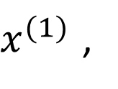
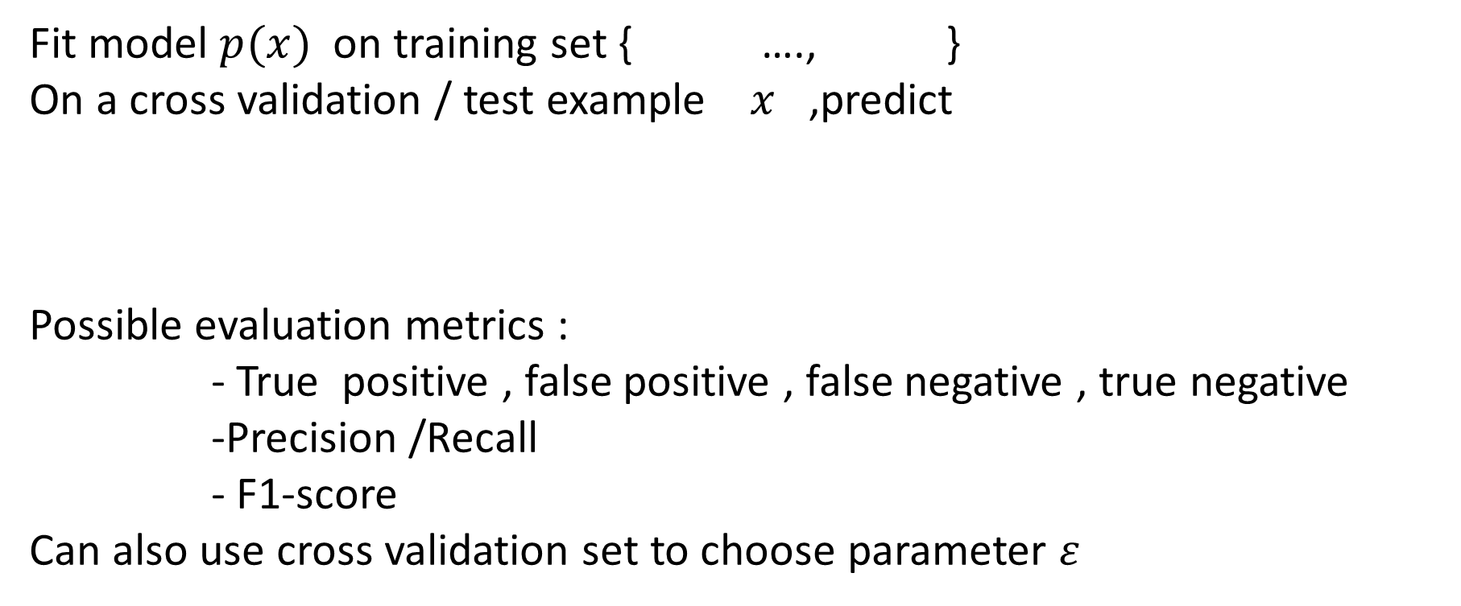
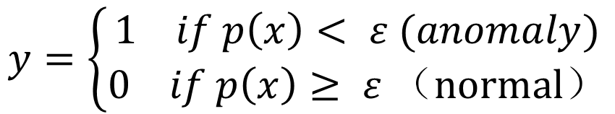

Algorithm evaluation
Fit model $p(x)$ on training set { …., }
On a cross validation / test example $x$ ,predict
Possible evaluation metrics :
- True positive , false positive , false negative , true negative
-Precision /Recall
- F1-score
Can also use cross validation set to choose parameter $ε$
$x^{(1)}$ ,
$x^{(m)}$
$$y=\left\{\begin{aligned}1 if p\left(x\right)< ε (anomaly) \\ 0 if p\left(x\right)≥ ε （normal）\end{aligned}\right.$$

Slide 22

To choose parameter $ε$
function [bestEpsilon bestF1] = selectThreshold(yval, pval)
bestEpsilon = 0;
bestF1 = 0;
F1 = 0;
stepsize = (max(pval) - min(pval)) / 1000;
for epsilon = min(pval):stepsize:max(pval)
predictions = (pval < epsilon);
fp = sum((predictions == 1) & (yval == 0));
fn = sum((predictions == 0) & (yval == 1));
tp = sum((predictions == 1) & (yval == 1));
prec = tp / (tp + fp);
rec = tp / (tp + fn);
F1 = 2 * prec * rec / (prec + rec);
if F1 > bestF1
bestF1 = F1;
bestEpsilon = epsilon;
end
end
end
P68

Slide 23
Anomaly detection
v s .
supervised learning

Slide 24
Anomaly detection
VS.
Supervised learning
Very small number of positive examples ( y = 1 ) .
Large number of negative ( y = 0 ) examples.
Many different “types” of anomalies. Hard for any algorithm to learn from positive examples what the anomalies look like;
Future anomalies may look nothing like any of the anomalous examples we have seen so far.
Large number of positive and negative examples.
Enough positive examples for algorithm to get a sense of what positive examples are like, future positive examples likely to be similar to ones in training set.

Slide 25
Anomaly detection
VS.
Supervised learning
Fraud detection
Manufacturing ( e . G . aircraft engines)
Monitoring machines in a data center
Email spam classification
Weather prediction (sunny / rainy / etc ).
Cancer classification

Slide 26
Choosing what features to use

Slide 27
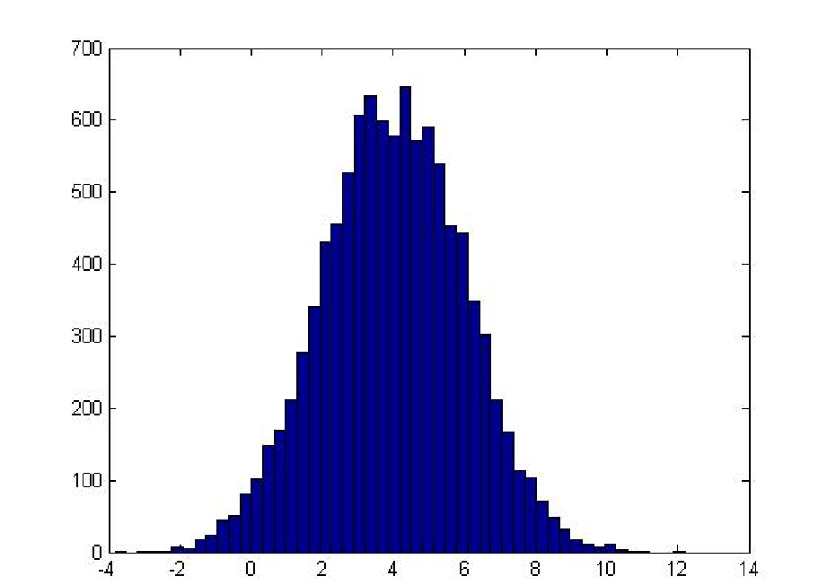
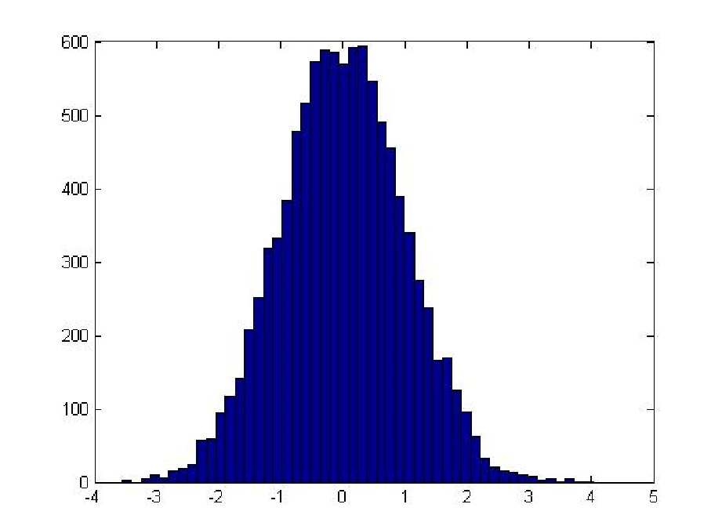
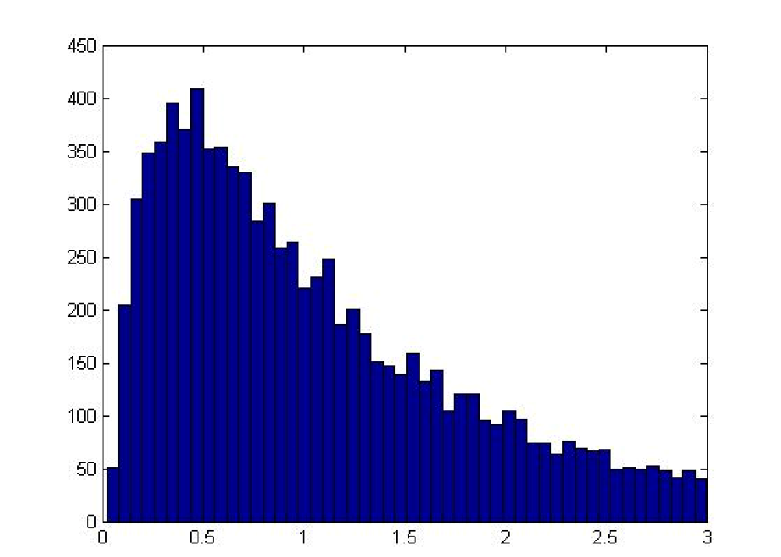
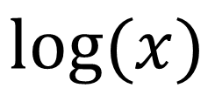
Non – Gaussian features
$$\log{(x)}$$

Slide 28
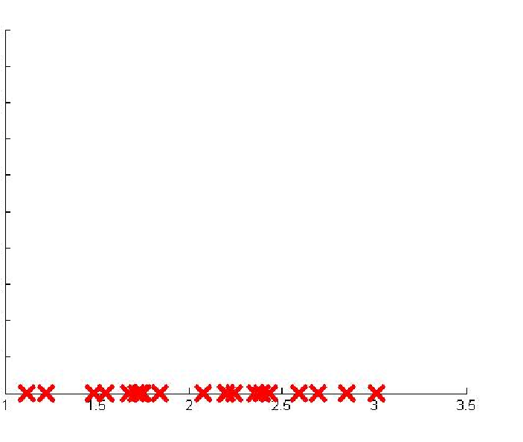
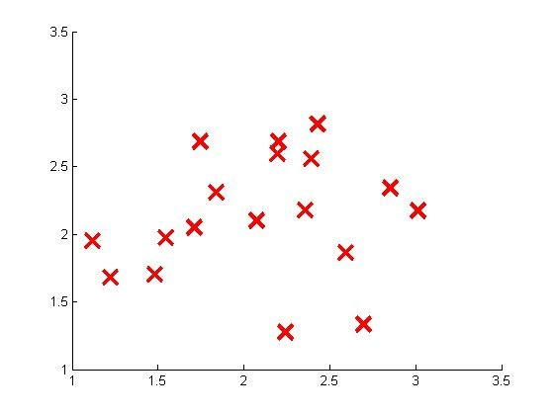



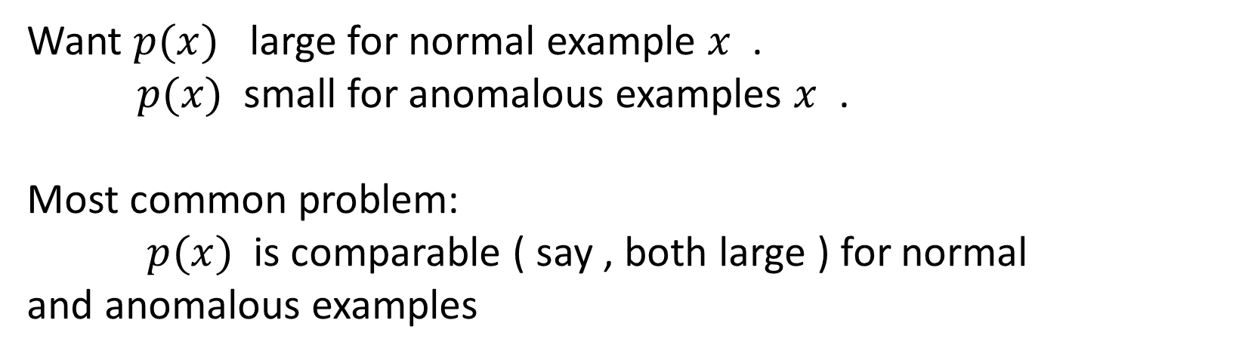
Error analysis for anomaly detection
Want $p(x)$ large for normal example $x$ .
$p(x)$ small for anomalous examples $x$ .
Most common problem:
$p(x)$ is comparable ( say , both large ) for normal
and anomalous examples
$$p(x)$$

Slide 29
Multivariate
Gaussian distribution

Slide 30
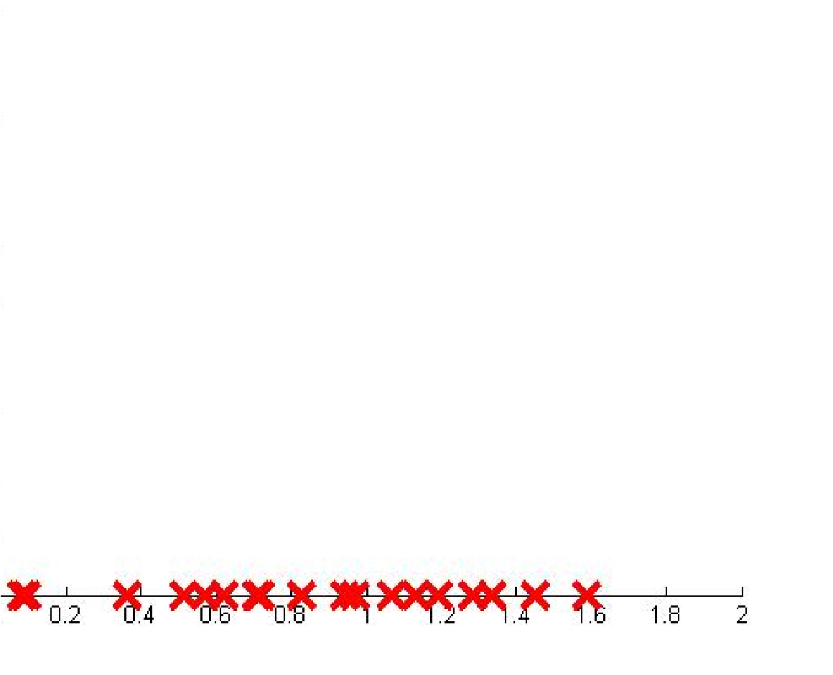
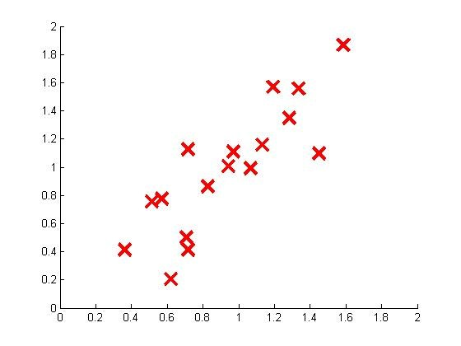

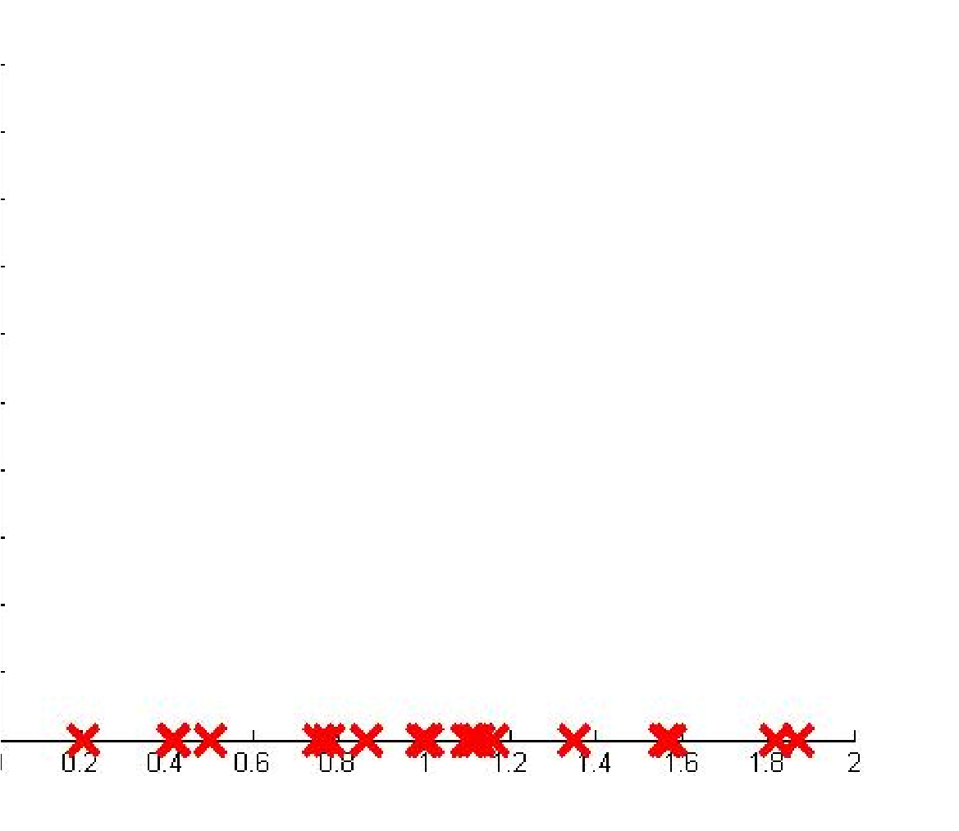

Motivating example : Monitoring machines in a data center
Memory Use)
(
CPU Load)
(
CPU Load)
(
Memory Use)

Slide 31
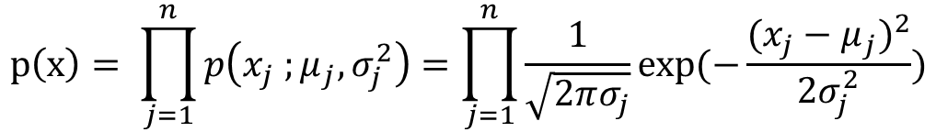

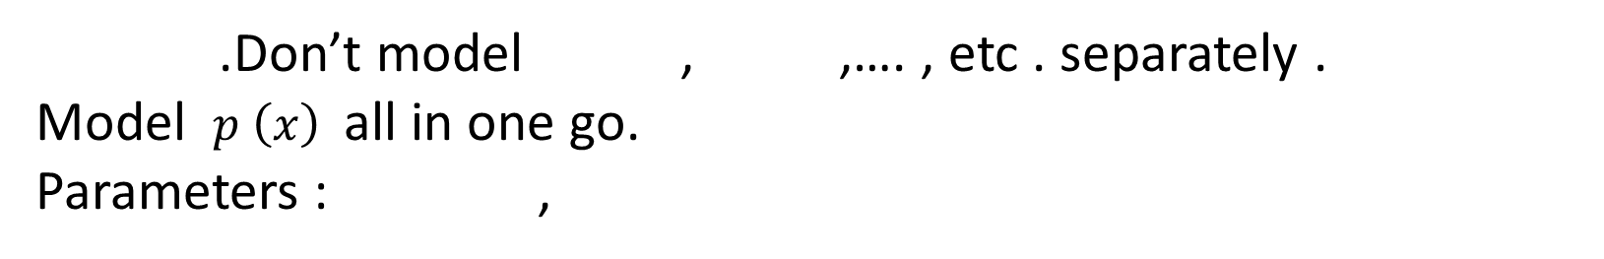

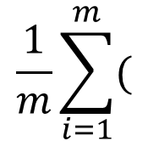



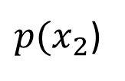
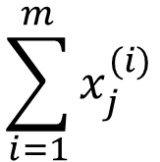



Multivariate Gaussian ( normal ) distribution
$$x ε R^{n}$$
.Don’t model , ,…. , etc . separately .
Model $p \left(x\right)$ all in one go.
Parameters : ,
$p(x_{1}$)
$p(x_{2}$)
$μ ε R^{n}$
$\sum{∈}R^{n×n}$
$$p\left(x\right)= \prod_{j=1}^{n}{p\left(x_{j} ;μ_{j},σ_{j}^{2}\right)=\prod_{j=1}^{n}{\frac{1}{\sqrt{2πσ_{j}}}exp⁡(−\frac{{(x_{j}−μ_{j})}^{2}}{2σ_{j}^{2}}}})$$
$$\sum_{i=1}^{m}{x_{j}^{(i)}}$$
$$\frac{1}{m}\sum_{i=1}^{m}{(}$$
$μ_{i}$=$\frac{1}{m}$
$$\sum{=}$$
$$x^{(i)}−μ){(x^{\left(i\right)}−μ)}^{T}$$
Multivariate Gaussian distribution:
$p(x;μ,∑)=\frac{1}{{(2π)}^{\frac{n}{2}}∑^{\frac{1}{2}}}$exp$(−\frac{1}{2}{(x−μ)}^{T}∑^{−1}$($x−μ))$

Slide 32









Multivariate Gaussian (normal) examples
p67

Slide 33






Multivariate Gaussian (normal) examples
p67

Slide 34






Multivariate Gaussian (normal) examples
p67

Slide 35






Multivariate Gaussian (normal) examples
p67

Slide 36






Multivariate Gaussian (normal) examples
p67

Slide 37






Multivariate Gaussian (normal) examples
p67

Slide 38
Multivariate Gaussian (normal) examples
p67
close all; clc; clear all;
mu = [0, 0];
sigmax = 1;
sigmay = 1;
rho = 0
sigmaxy = sigmax * sigmay * rho;
Sigma = [sigmax^2, sigmaxy;
sigmaxy, sigmay^2];
x = -4 : 0.01 : 4;
y = x;
[pMat, xMat, yMat] = gaussian2d(mu, Sigma, x, y);
fprintf('The integration of p with respect to x and y is %.4f\n',...
trapz(y, trapz(x,pMat)));

Slide 39
Anomaly detection
using
the multivariate Gaussian distribution

Slide 40













Multivariate Gaussian ( normal ) distribution
Parameters $μ$, $\sum{,}$
Parameter fitting:
Given training set:{ , ,….., }
$p(x;μ,∑)=\frac{1}{{(2π)}^{\frac{n}{2}}∑^{\frac{1}{2}}}$exp$(−\frac{1}{2}{(x−μ)}^{T}∑^{−1}$($x−μ))$
$x^{(1)}$
$x^{(2)}$
$x^{(m)}$
$$\sum_{i=1}^{m}{x^{(i)}}$$
$$\sum_{i=1}^{m}{(x^{(i)}}$$
$μ$ = $\frac{1}{m}$
$\sum{=}$ $\frac{1}{m}$
-$μ){(x^{\left(i\right)}−μ)}^{T}$

Slide 41










Anomaly detection with the multivariate Gaussian
1.Fit model $p \left(x\right)$ by setting
$$\sum_{i=1}^{m}{x^{(i)}}$$
$μ$ = $\frac{1}{m}$
$$\sum_{i=1}^{m}{(x^{(i)}}$$
$\sum{=}$ $\frac{1}{m}$
-$μ){(x^{\left(i\right)}−μ)}^{T}$
2.Given a new example $x$ ,compute
$p(x;μ,∑)=\frac{1}{{(2π)}^{\frac{n}{2}}∑^{\frac{1}{2}}}$exp$(−\frac{1}{2}{(x−μ)}^{T}∑^{−1}$($x−μ))$
Flag an anomaly if $p\left(x\right)<ε$

Slide 42






Relationship to original model
Original model:
$p\left(x\right)=P(x_{1};μ_{1}$,$σ_{1}^{2}$)$×p(x_{2}$;$μ_{2}$,$σ_{2}^{2}$)$×….×p(x_{n}$;$μ_{n}$,$σ_{n}^{2}$)
Corresponds to multivariate Gaussian
where
$p(x;μ,∑)=\frac{1}{{(2π)}^{\frac{n}{2}}∑^{\frac{1}{2}}}$exp$(−\frac{1}{2}{(x−μ)}^{T}∑^{−1}$($x−μ))$

Slide 43




Original model
VS.
Multivariate Gaussian
$P(x_{1};μ_{1}$,$σ_{1}^{2}$)$×…×p(x_{n}$;$μ_{n}$,$σ_{n}^{2}$)
$p(x;μ,∑)=\frac{1}{{(2π)}^{\frac{n}{2}}∑^{\frac{1}{2}}}$exp$(−\frac{1}{2}{(x−μ)}^{T}∑^{−1}$($x−μ))$
Manually create features to capture anomalies where $x_{1}$ ,$x_{2}$ take unusual combinations of values.
Computationally cheaper (alternatively ,scales better to large)
OK even if $m$ (training set size ) is small
Automatically captures correlations between features
Computationally more expensive
Must have or else $∑$ is non-invertible
$$m >n$$

Slide 44
Thanks
Machine Perception and Interaction Group (MPIG)
www.mpig.com.cn
yhh@mpig.com.cn
公众号:
mpig_robot

